Slide 1
The Critical Role of Partnerships in HCV Elimination, Georgia
Dr. David Sergeenko
Minister of Internally Displaced Persons from Occupied
Territories, Labor, Health, and Social Affairs
Vienna, Austria; 11th of April

Slide 2
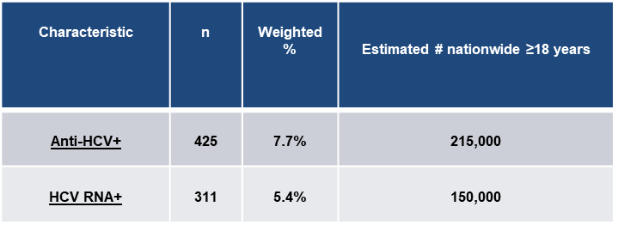

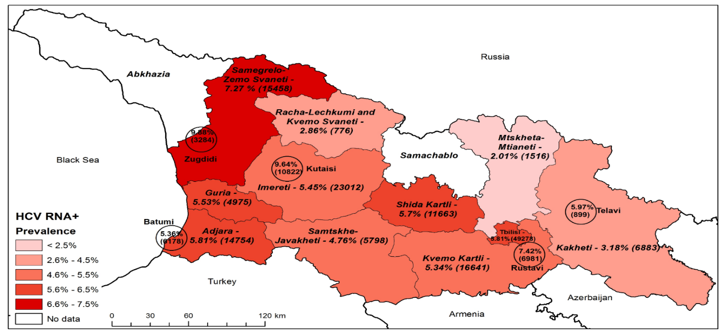
Georgia- A High HCV Prevalence Country
Goal
Elimination of HCV by ensuring prevention, diagnostics and treatment of the disease
Targets
90-95-95
By 2020
90% of people living with HCV are diagnosed
95% of those diagnosed are treated
95% of those treated are cured

Slide 3
The Process of HCV Elimination in Georgia
March, 2019
2016
Sofosbuvir + ledipasvir (Harvoni)
1.35 million adults have been screened- 48% of the target
54,000 persons treated/enrolled in treatment- 42% of the target
To be implemented in 2019 - Sofosbuvir+Velpatasvir+ voxilaprevir (Vosev)
42 Treatment centers
May 2015
Program started
Sofosbuvir + pegilated interferon alpha + ribavirin
4 Treatment centers
2018
Sofosbuvir +Velpatasvir (Epcluza)

Slide 4
  Initial Partners & Their Roles
Georgian Government
Gilead Sciences
U.S. CDC

Slide 5
Partners
CDC
EASL
LIFER
WHO
Global Fund
FIND
ECHO
University of Bristol, UK
Abbot Laboratories
Gilead
World Hepatitis Alliance and NOhep Vision
Technical Advisory Group
Local Partners

Slide 6

CDC South Caucasus Office and partnership with the CDC
Division of Viral Hepatitis
-Technical Support
Country Office
- Technical support
-Scientific and IT assistance
Division of Healthcare Quality Promotion
-Technical assistance for infection prevention and control
Division of Global HIV & TB
-Technical assistance for blood safety and infection prevention and control
Scientific committee
Clinical committee

Slide 7

GILEAD Sciences
Drug Donation:
2015 - Sofosbuvir
2016 - Sofosbuvir + ledipasvir (Harvoni)
2018 - Sofosbuvir +Velpatasvir (Epcluza)
To be implemented in 2019 - Sofosbuvir+Velpatasvir+ voxilaprevir (Vosev)
Infrastructure development
IT system strengthening
Scientific project funding
HCV management center in Zugdidi

Slide 8


World Health Organization and The Global Fund
Technical support
Study tours of Several Countries to Georgia to share the Georgian experience
Surveillance assistance
Mortality study
Pilot project: Integrated screening of HIV/HCV/TB at the primary healthcare level in the Samegrelo-Zemo Svaneti region (West Georgia)
Extending the pilot project on the country level

Slide 9

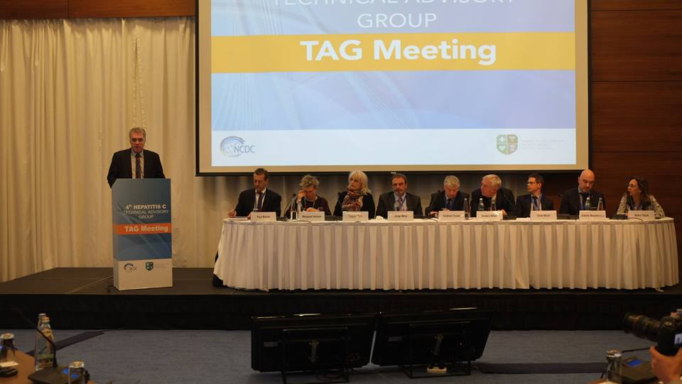
EASL – International Liver Foundation (EASL – ILF) and
the Technical Advisory Group (TAG)
  Nominated Georgia as a Center of Excellence for Hepatitis Elimination
  Training for decentralized care and treatment
  Web portal development
  Scientific studies support
Four Annual Technical Advisory Group meetings 2015-2018
Elaborated recommendations given annually

Slide 10


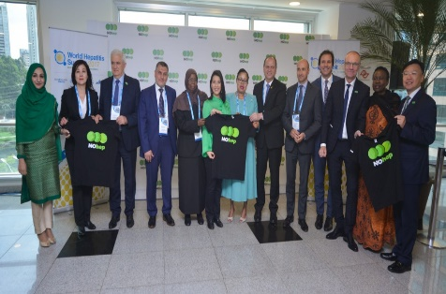
World Hepatitis Alliance and NOhep Vision
The Georgian HCV Patients Association became a member of the World Hepatitis Alliance in 2018
Georgia participated in the world Hepatitis Summit in 2015, 2017
Georgia was awarded the title of NOhep Visionary for the European Region at the World Hepatitis Summit in Sao Paulo, Brazil, on November 1st, 2017

Slide 11


Extension for Community Healthcare Outcomes (ECHO) and Liver Institute and Foundation for Education and Research (LIFER)
ECHO clinics and hubs for clinicians
2015- 4 sites (specialized HCV providers)
2019-42 sites (both specialized and non-specialized HCV providers)
Technical support
Support for decentralization
Training/online consultations for public health center epidemiologists
  Supported clinical training
  Simplified regimen protocol development
  Funding for scientific studies and workshops
  In 2015, the first symposium was conducted on the HCV Elimination Program for Georgia

Slide 12

Foundation for Innovative New Diagnostics (FIND)
Decentralization of HCV molecular diagnostics at 4 HRSs – HEAD start project
Integration to decentralization to assist in current HCV care decentralization efforts, using existing GeneXpert platforms performing HCV diagnostic tests (Total 15 sites)
Reinfection, SVR 12 and SVR missing testing at 4 HRSs
Supporting the National Data base
Planning to support of the cohort who have been screened but have not linked to next step of HCV care (Preparing)
6. Studies:
  Clinical evaluation on GeneXpert Fingerstick HCV cartridges
  Evaluation of HCV rapid diagnostic test
  HCV Gendrive study (Preparing)
  HCV core antigen as test of cure study (Preparing)
  HCV DBS validation study (Preparing)

Slide 13


University of Bristol, UK and Abbott Laboratory
  Modelling Work
  Program Cost-effectiveness evaluation
  HCV laboratory diagnostics & Reagents

Slide 14
Local Partners
Treatment Providers: AIDs Center, Neolab, Mrcheveli and Hepa and other clinics
Municipal public health centers
Harm Reduction Centers
Ministry of Justice of Georgia and Public Service Halls
Local Municipal Governments
State Ministry for Reconciliation and Civic Equality of Georgia
National Center for Disease Control and Public Health

Slide 15





Acknowledgements
HCV Elimination Program Providers
TAG Members

